Slide 1

4M20 Robotics
Ethan Silverstone & Harvey Hughes

Slide 2
Approach
Inverse Kinematics
Define stages to move between to achieve motion
Polynomial trajectory fitting
Adjustable speed
Centre of Mass calculations
Adjust for real robot

Slide 3
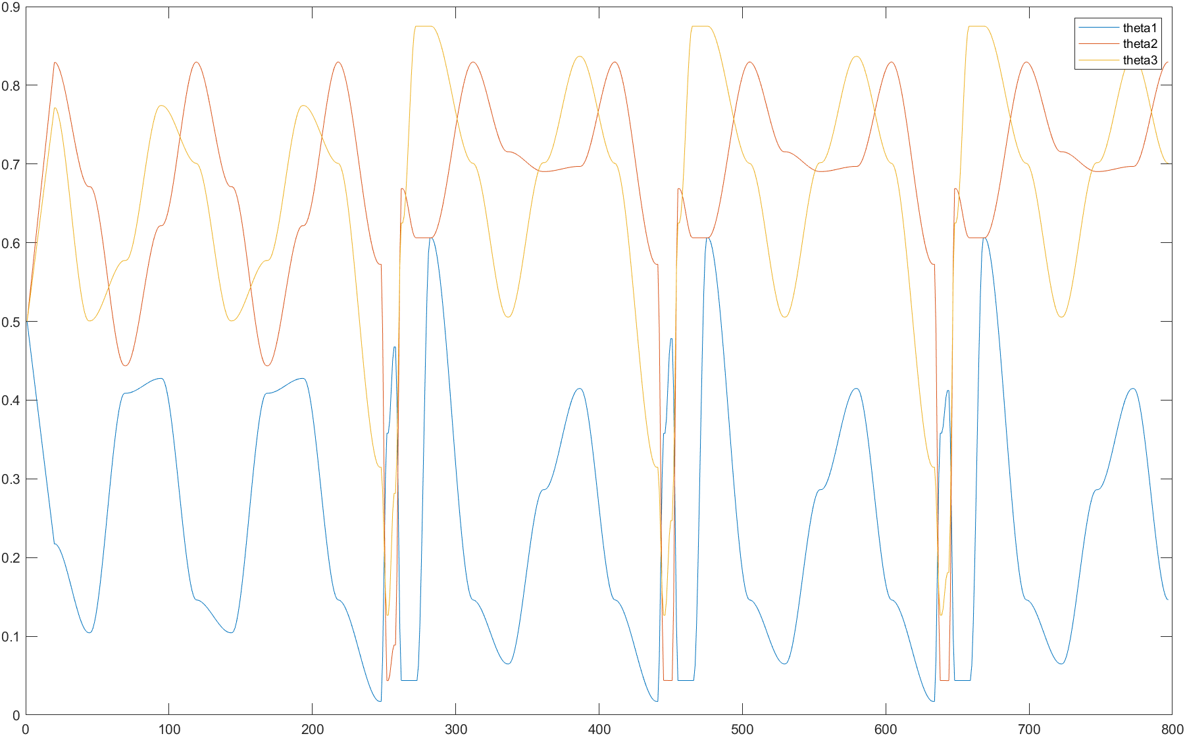
Polynomial Fitting
Initial Walk
Step One
Step Two
Step Three

Slide 4
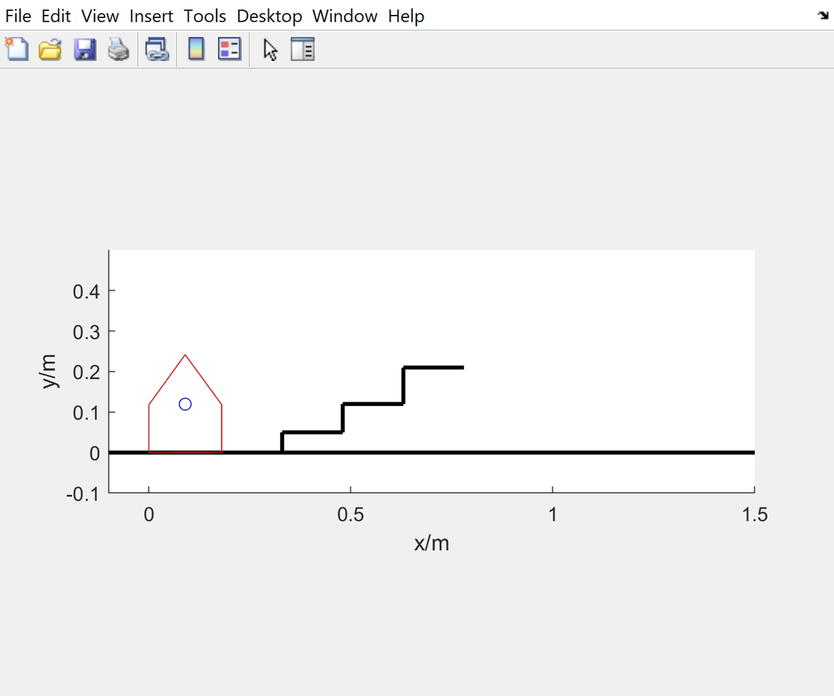
Simulation

Slide 5
Changes Required for Real Robot
Shorter lower legs
Longer middle beams
Extra grip
Stiffer feet
Mass for balance

Slide 6
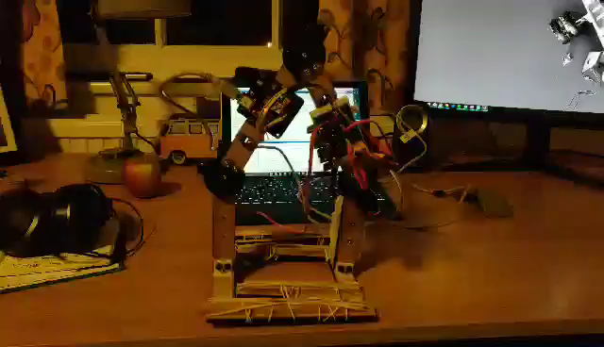
Robot Walking
Mean: 87.6mm
σ: 1.84mm

Slide 7
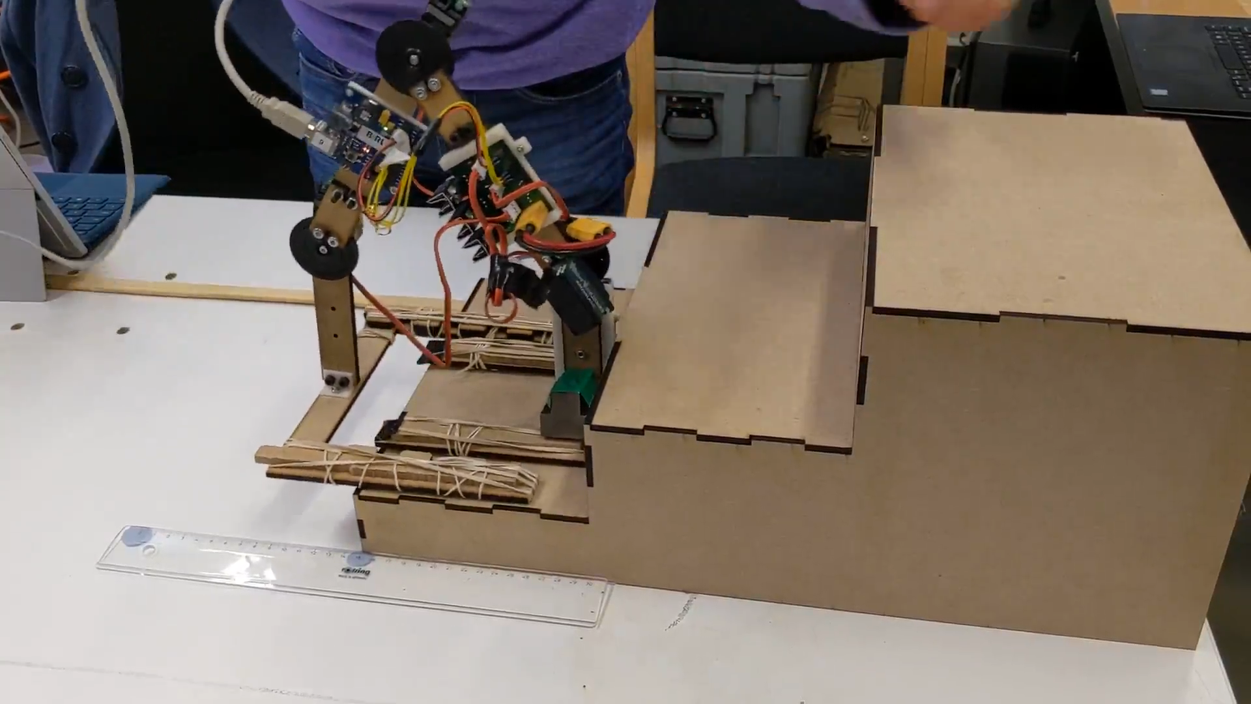
Robot Climbing

Slide 8
Future Work
Extra grip
Tweak stages
Kinematic simulation

Slide 9

Thank You Any Questions

